Slide 1


CSE449
EDA Presentation
Fine-Tuning BERT for NLP Tasks on High-Performance Computing (HPC) Infrastructure Using Multiple GPUs on Single Node
Presented by
Munib Fahmid Rafeed - 24341128
Moinuddin Zubair - 21101223
Tarannum Ahmed Nowshin-21101210
Kamran Hassan Shomrat - 21101010
Upoma Deb Suchi - 20201109

Slide 2



INDEX
1
Dataset Description
6
Essay Length vs. Overall Score
2
Key Features
7
Overall Scores by Task Type
3
Other Features
8
Correlation Between Essay Length and Overall Scores
4
Distribution of Overall Scores
9
Word Cloud of Essays & Word Cloud of Examiner Comments
5
Distribution of Essay Lengths

Slide 3

DATASET DESCRIPTION
The dataset contains 1435 entries and is centered on IELTS writing tasks. It includes essays written by participants, along with task details and overall scores.

Slide 4

Task_Type:
Represents the type of writing task (e.g., essay, report).
Overall:
Represents the type of writing task (e.g., essay, report).
Question:
The overall score assigned to each essay, reflecting its quality.
KEY FEATURES
Examiner_Comment:
Sparse feedback provided by examiners for a subset of entries.
Essay:
The written responses of participants

Slide 5
Other Features
Most essays are scored, but other columns like Task_Response, Coherence_Cohesion, etc., are empty. This dataset is suitable for natural language processing tasks such as essay scoring, linguistic pattern analysis, and understanding correlations between essay characteristics and scores.

Slide 6
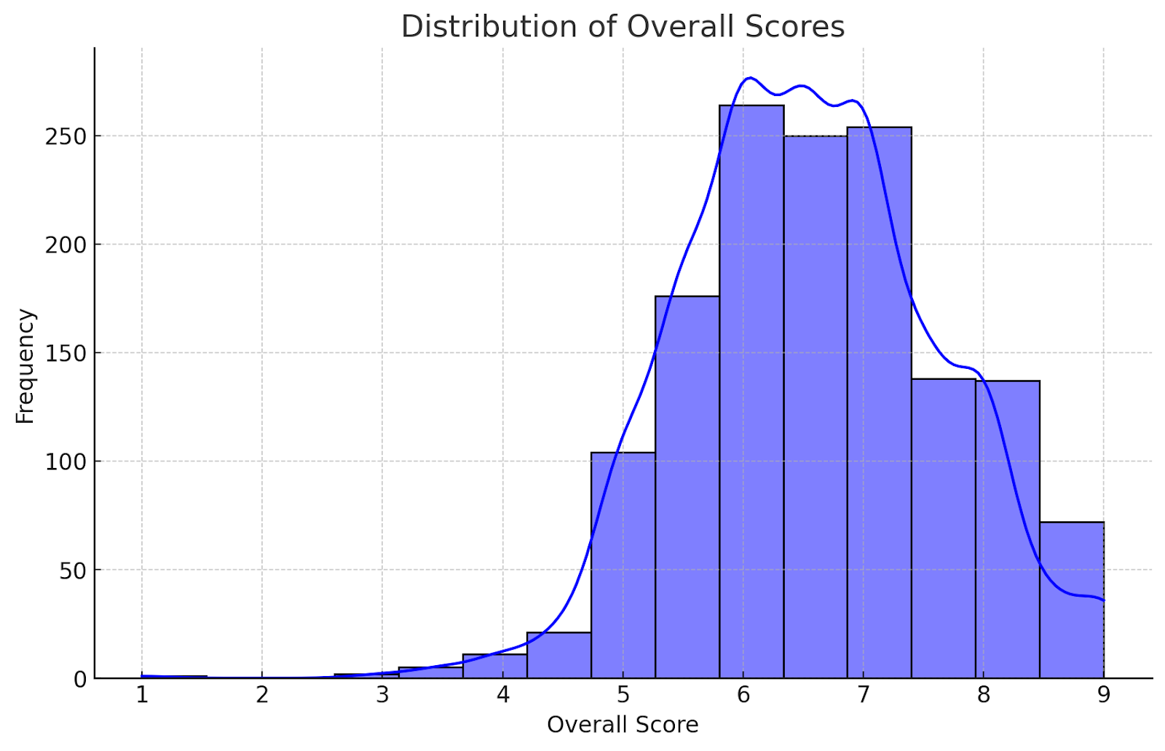
Distribution of Overall Scores
The scores range from 0 to a higher value, with most essays clustering around a specific score range. This gives insight into the scoring tendencies.

Slide 7
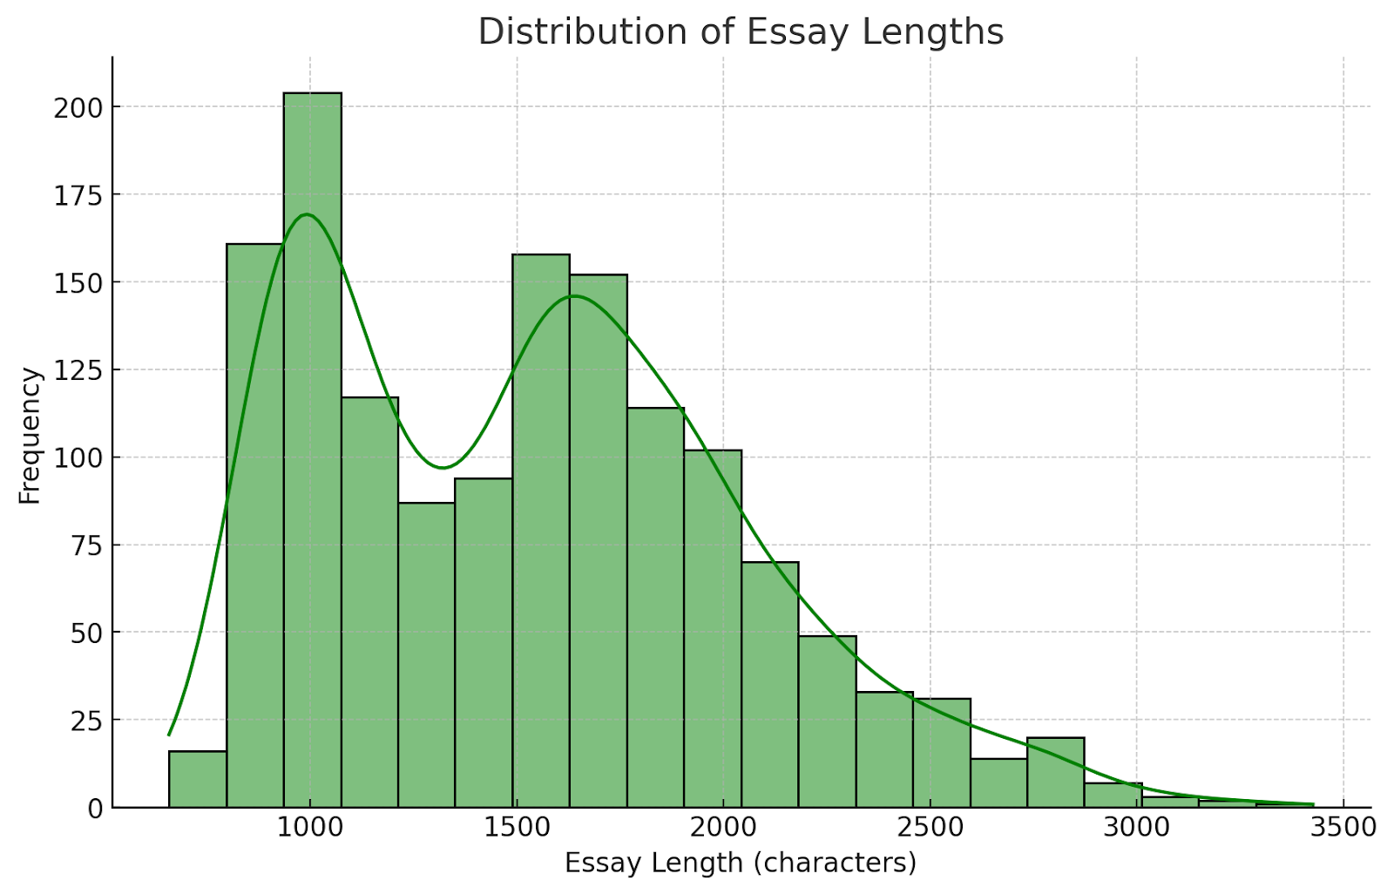
Distribution of Essay Lengths
This scatter plot shows how essay length correlates with the overall score. Different task types are color-coded to observe variations across tasks.

Slide 8
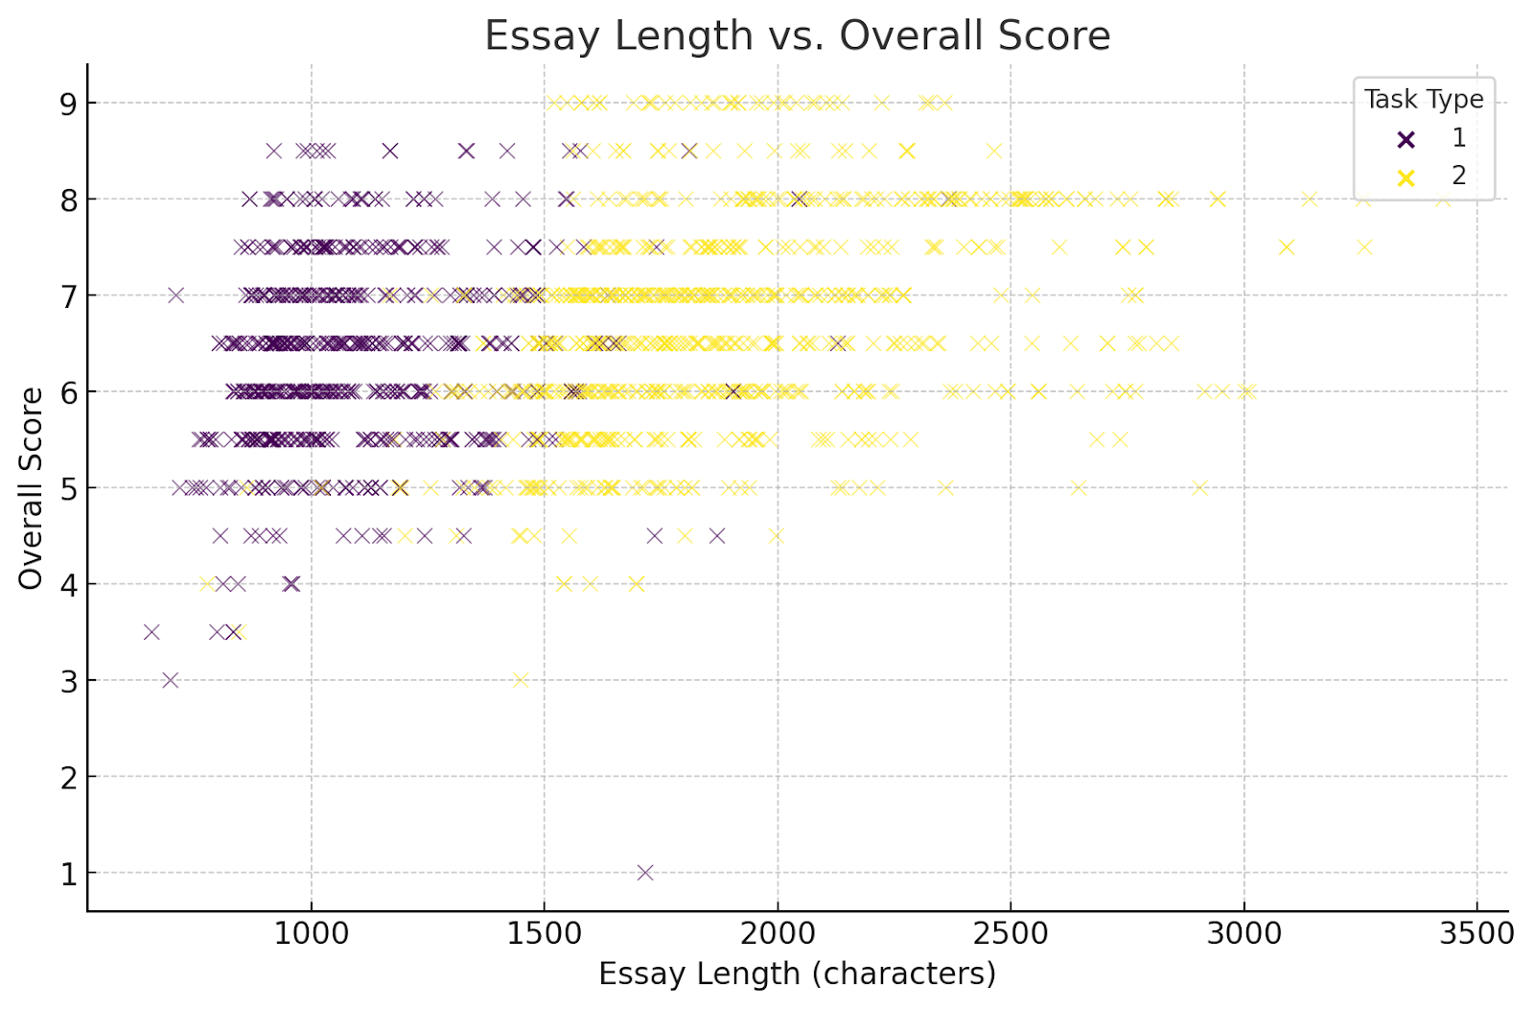
Essay Length vs. Overall Score
This scatter plot shows how essay length correlates with the overall score. Different task types are color-coded to observe variations across tasks.

Slide 9
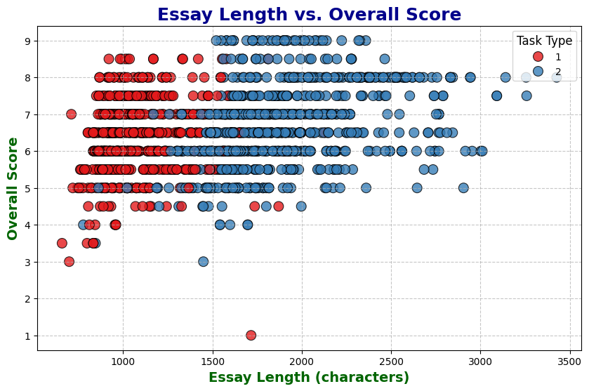
Overall Scores by Task Type
The box plot shows the distribution of scores across different task types. This can help identify which tasks tend to have higher or more varied scores

Slide 10
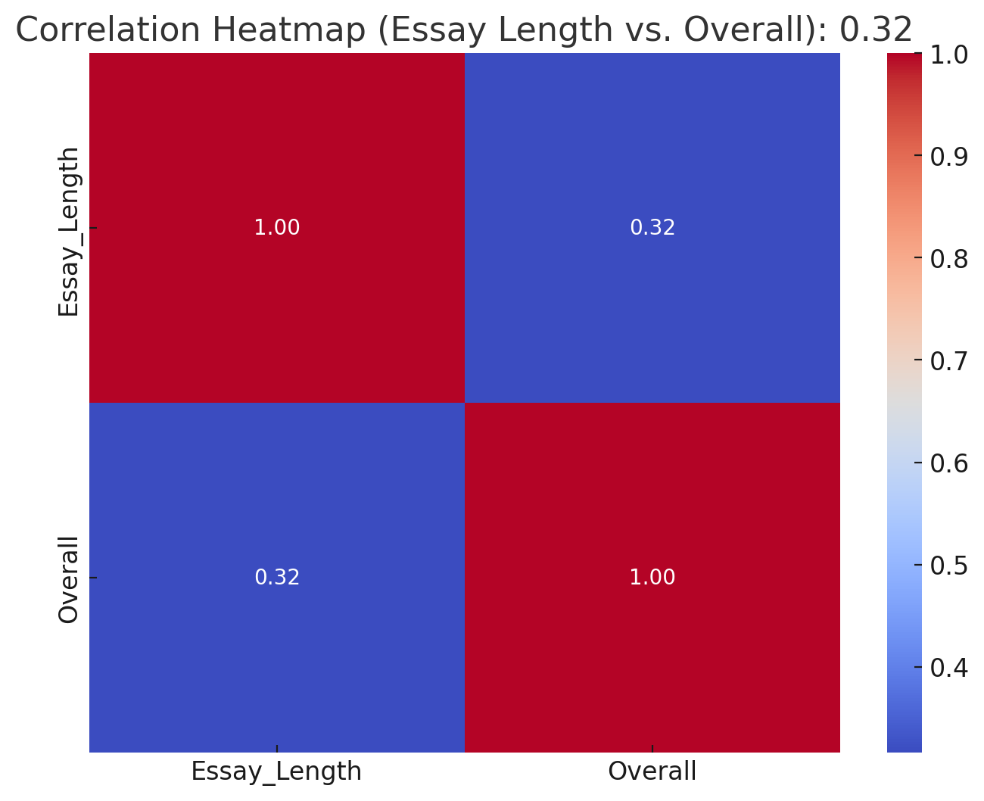
Correlation Between Essay Length and Overall Scores
The heatmap reveals a correlation coefficient between essay length and overall scores. The strength of this correlation might provide insight into how essay length impacts scoring.

Slide 11
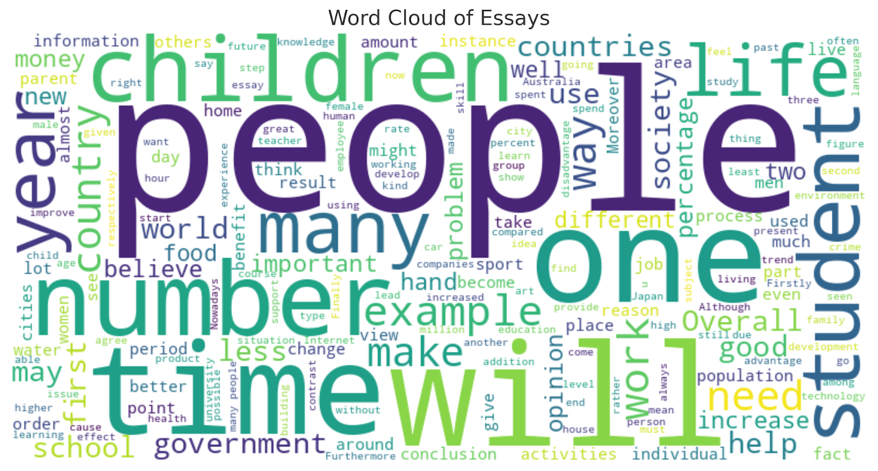
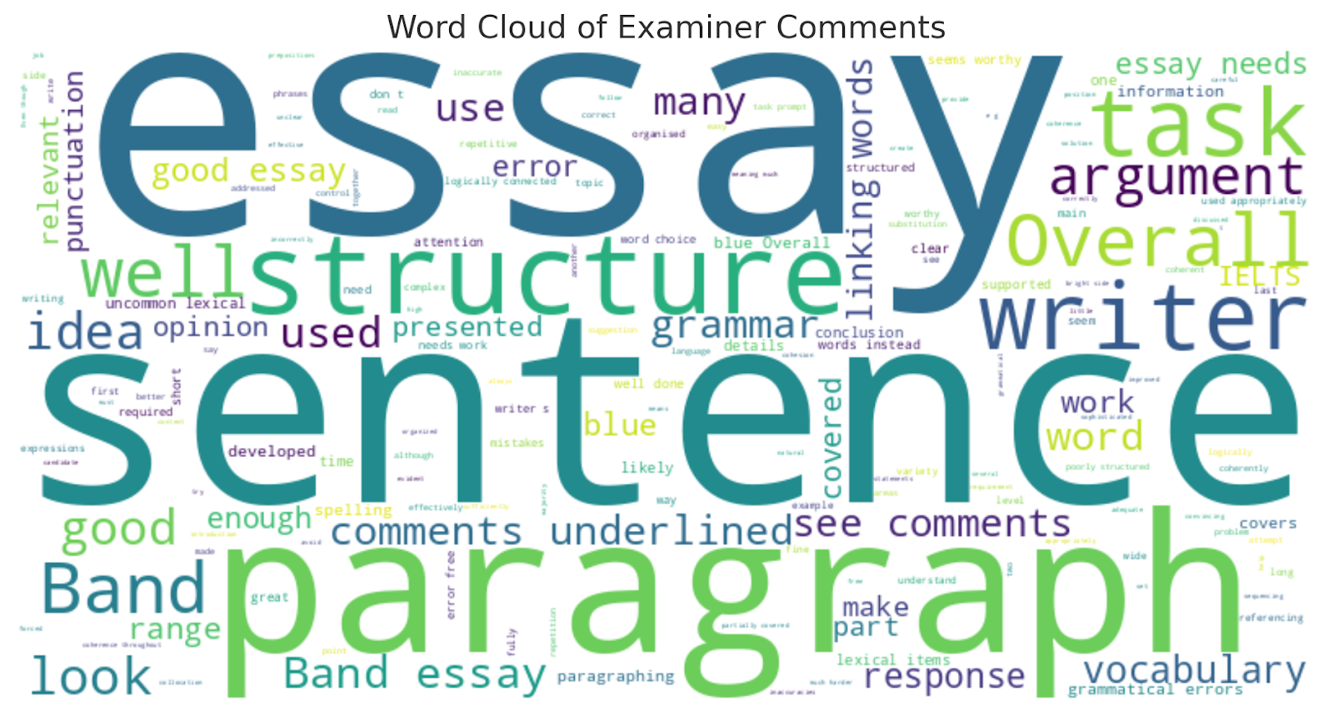
Word Cloud of Essays
Word Cloud of Examiner Comments
Examiner comments were sparse in the dataset, but a word cloud was generated if sufficient data was available. Otherwise, there isn't enough data for a meaningful analysis.
Frequent terms used in the essays are visualized. Commonly used words might reflect key themes or typical responses to the tasks.

Slide 12
THANK YOU !!!

